Slide 1
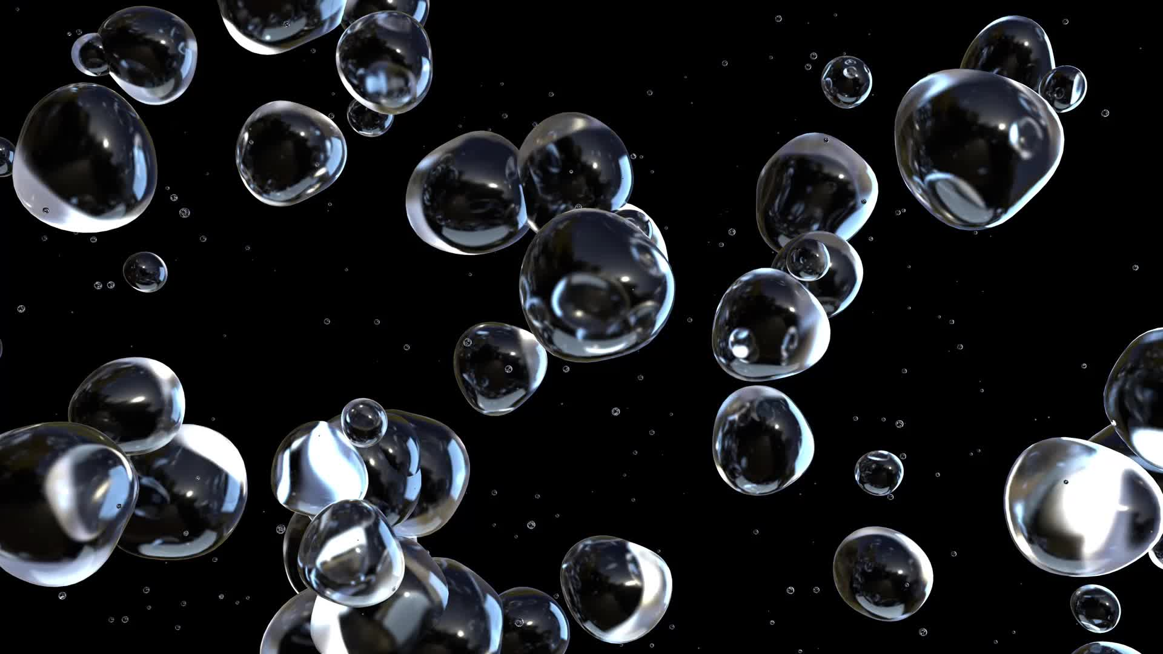
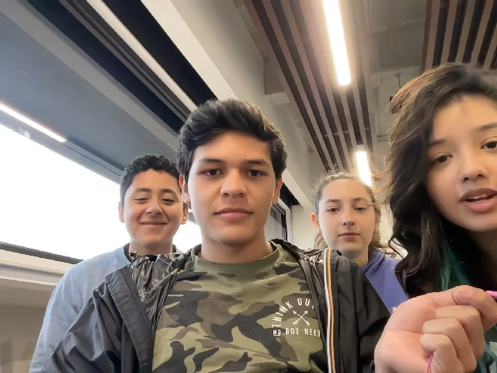
Bubble Sort
Alina Carías (22539)
Ignacio Méndez (22613)
Ariela Mishaan (22052)
Diego Soto (22737)

Slide 2
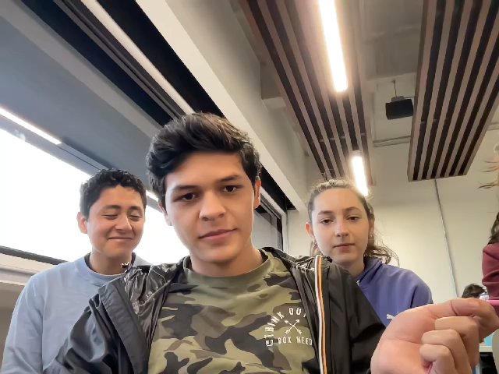
Caso promedio O(n²)
3 | 4 | 7 | 8 | 1 | 2
3 | 4 | 7 | 1 | 2 | 8
3 | 4 | 1 | 2 | 7 | 8
3 | 1 | 2 | 4 | 7 | 8
1 | 2 | 3 | 4 | 7 | 8

Slide 3
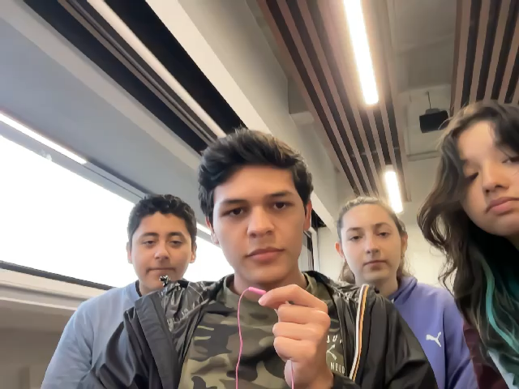
Peor caso O(n²)
8 | 7 | 4 | 3 | 2 | 1
7 | 4 | 3 | 2 | 1 | 8
4 | 3 | 2 | 1 | 7 | 8
3 | 2 | 1 | 4 | 7 | 8
2 | 1 | 3 | 4 | 7 | 8
1 | 2 | 3 | 4 | 7 | 8

Slide 4
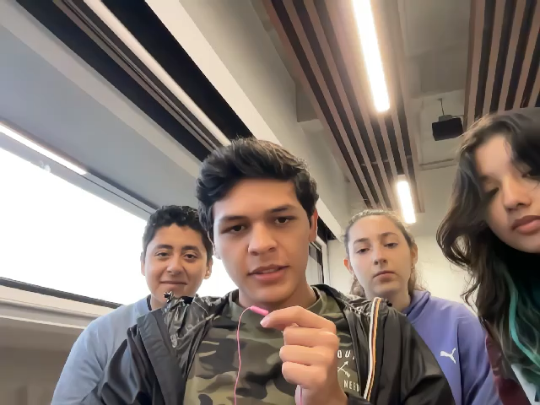
Mejor caso O(n)
1 | 2 | 3 | 4 | 7 | 8

Slide 5
